Slide 1



University of Southern Denmark Opportunities for your research and innovation
EVP Tore Duvold, 2 November 2018

Slide 2
From science to value
1
2
3
SDU Science
IFD-investment
Value
Notes:
Well-recognized research, education and innovation
National and international collaborations and talents
Scientific/innovative solutions to societal challenges
8 bn DKK active portefolio
1800 active projects
250 Int. projects
3300/yr project proposals
1.5 bn DKK in 2019

Slide 3

IFD Regional model
Headquarter in Aarhus is under establishment
Aarhus, Odense, Aalborg and Copenhagen
Strengthening the regional presence across Denmark
4-5 employees in Odense

Slide 4
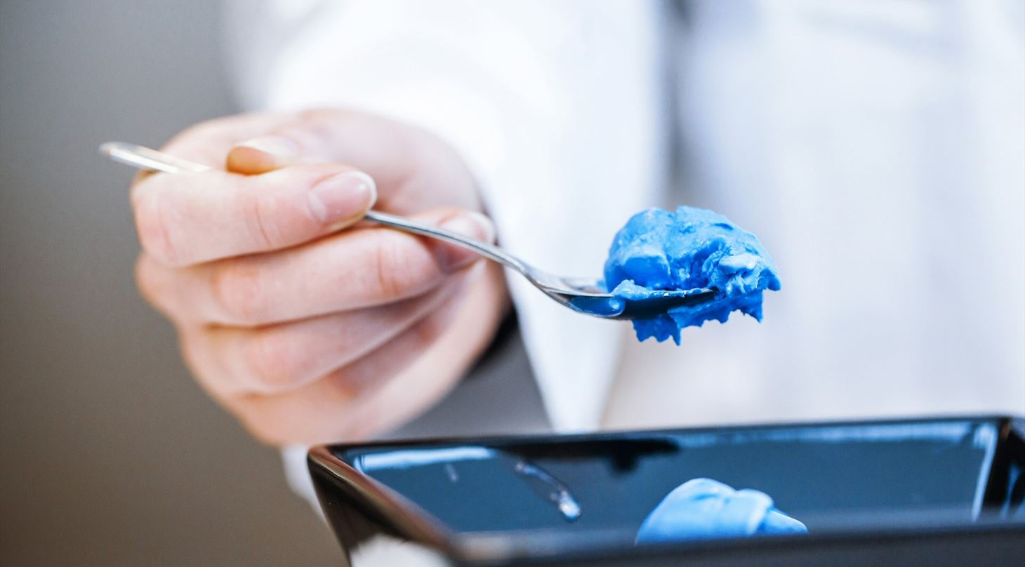
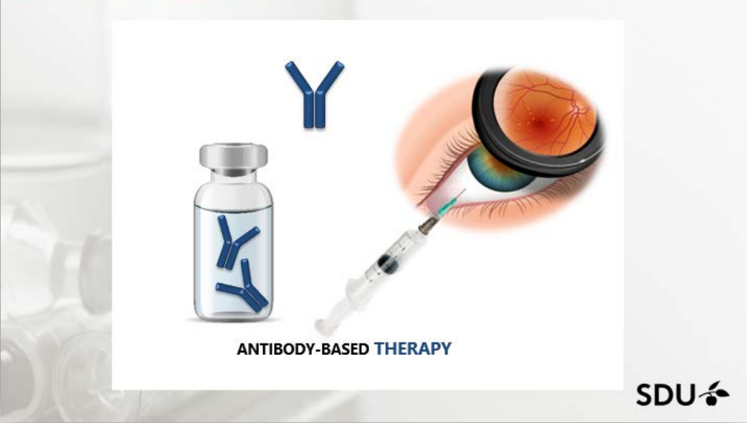
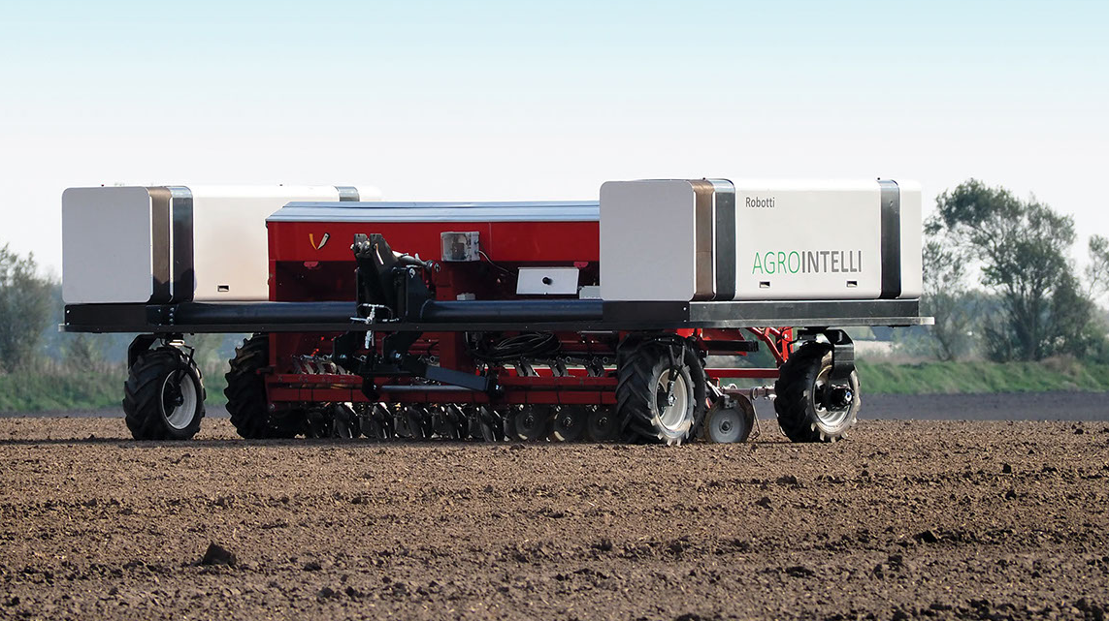
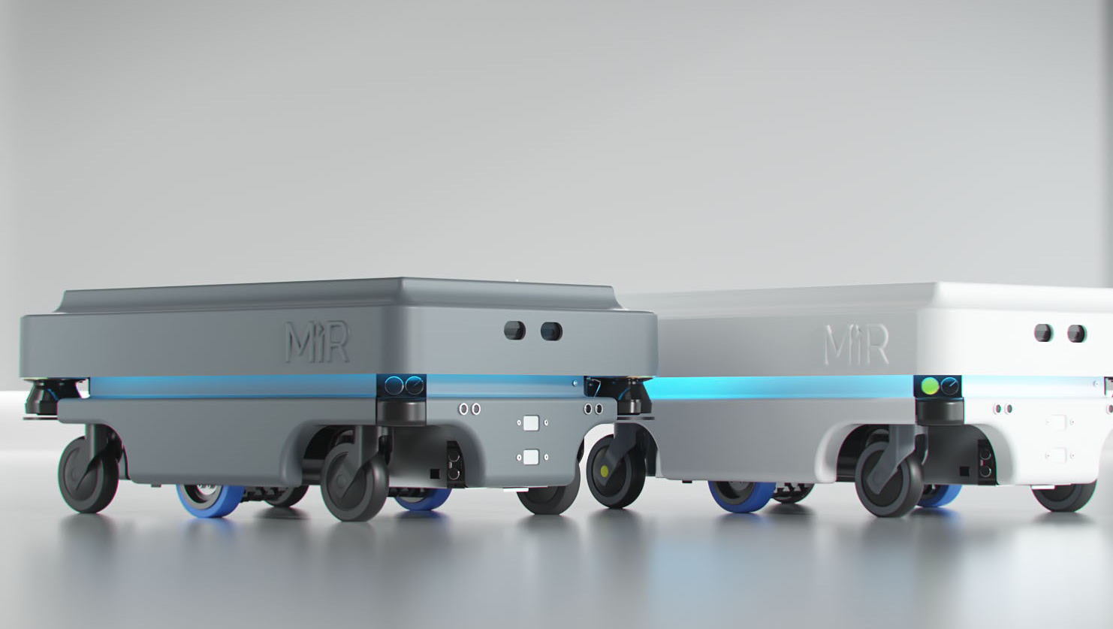
SDU and IFD
– value for our society
Notes:
Billede ØVERST TIL VENSTRE
INVESTERING KNÆKKER BLÅ FARVEKODE
FORSKERE HAR FUNDET NY METODE TIL AT FREMSTILLE HELT NATURLIGT BLÅT FARVESTOF - I FØRSTE OMGANG ER DET LYKKES FORSKERNE AT TILFØJE DEN NATURLIGE BLÅ FARVE I FLØDEIS.
Teknologisk Institut har sammen med en række partnere udviklet en ny skånsom oprensningsmetode til ekstraktion af blå farve fra spirulina-alger. Produktet er testet i flødeis i samarbejde med Premier Is med et flot, naturligt blåt produkt som resultat.
EKSISTERENDE NATURLIG BLÅ FARVE GIVER KEDELIG OG GRÅ IS
Naturens egne farver har sjældent de samme egenskaber som de syntetiske. Farvetonen ændres over tid ved påvirkning fra lys, varme eller pH-ændringer, og her er blå farve en særlig udfordring. Ved produktionen af is pumpes der store mængder luft ind i ismassen, hvilket får de nuværende kommercielle naturlige blå farver til at blive gråblå og kedelige.
Premier Is, Caldic Ingredients Denmark, Institut for Kemi-, Bio- og Miljøteknologi (Syddansk Universitet) og Teknologisk Institut er derfor med investering fra Innovationsfonden gået sammen om at udvikle en metode til produktion af en stabil naturlig blå farve ud fra et blåt proteinkompleks (phycocyanin) fra spirulina-alger.
BILLEDE ØVERST TIL HØJRE
DARE THERAPEUTICS - DEVELOPING A NEXT GENERATION TREATMENT FOR WET AMD AND DME (14 millioner kr. Fra iNNOVATIONSFONDEN)
DARE Therapeutics - Developing a next generation treatment for wet AMD and DME Biotech and Pharma Value Proposition We have identified a novel target; namely microfibrillar-associated protein 4 (MFAP4) and have produced and humanized a new antibody targeting MFAP4. The antibody is a candidate for stand-alone or combination therapeutics against conditions involving neovascularization, inflammation and fibrosis in the eye and therefore potentially targets vascular ophthalmic complications such as wet (advanced) age-related macular degeneration (AMD) and diabetic macular edema (DME), and especially targets the large patient group not responding to therapies offered today (anti-VEGF). Business Opportunity We believe that when the anti-MFAP4 therapy is successfully developed, a high market penetration among the non-respondent patient group would be expected. In this scenario, the estimated anti-MFAP4 therapy would benefit 4.25 million anti-VEGF non-responders with a global market size of approximately $860 million per year. Furthermore, having shown efficacy in the anti-VEGF non-responders, the anti-MFAP4 treatment might be able to challenge current first-line treatments due to the significant expected advantages, thus gaining a market share of the anti-VEGF respondent market. Technology Description Our target MFAP4 is fixed in the extracellular matrix and is permissive for integrin-dependent activation of inflammatory and vascular cells, causing inflammation and vascular growth. These observations suggested that anti-MFAP4 might reduce inflammation and neovascularization and have long half-life. MFAP4 is further associated to fibrotic deposition and is an inducer of fibrosis. These observations render MFAP4 an obvious target in wet AMD and DME, as these conditions are caused by pathological neovascularization in the eye and because integrin activation is a known inducer of neovascularization. Furthermore, inhibition of integrin signaling with blocking antibodies against integrin has been and is still under exploration for human administration in the eye. Current State We have just received 14 million DKK investment from Innovationsfonden for the late pre-clinical development phase; establishing Proofof-Concept in the gold standard Macaca model of wet AMD and differentiation-to-standard care by reduced pathological fibrosis and inflammation, less systemic side effects and reduced injection frequency. Prior to GMP production of our antibody and moving into clinical trials, we plan to incorporate DARE Therapeutics ApS and are seeking investment hereto.
The inventors Professor Uffe Holmskov, uholmskov@health.sdu.dk Associate Professor Grith L. Sørensen, glsorensen@health.sdu.dk Associate Professor Anders Schlosser, aschlosser@health.sdu.dk Institute of Molecular Medicine, University of Southern Denmark
Billede NEDERST TIL VENSTRE
ROBOTTER HJÆLPER TIL I MARKEN
FØRERLØSE TRAKTORER ER BLEVET SÅ SIKRE, AT TRAKTORFØREREN ER BLEVET UDSKIFTET MED EN ROBOT.
Robotti, som robottraktoren hedder, er førende inden for sikkerhed, og med evnen til at ’se’ kan den navigere udenom forhindringerne på marken.
Med investering fra Innovationsfonden er det lykkes forskere og virksomheder i samarbejde at give robottraktorerne evnen til selv at navigere ved hjælp af forskellige former for sensorer. Det sikrer, at alle forhindringer registreres, og robotten kan reagere ud fra dataene. Den reagerer ved for eksempel at stoppe, køre udenom eller hæve arbejdsredskabet. Den nye danske robottraktor er blandt de mest sikre af slagsen i hele verden.
Den første Robotti er allerede solgt og kører rundt i Norge. Interessen for traktorerne er stor, og forventningen er, at der i løbet af det næste år vil blive solgt 20 mere.
Billede nedERST TIL højre
DANSKE ROBOTTER EROBRERVERDEN
EN RÆKKE STRATEGISKE INVESTERINGER FRA INNOVATIONSFONDEN HAR VÆRET MED TIL AT GØRE ODENSE TIL INTERNATIONALT KENDT OG ANERKENDT ROBOTKLYNGE. SENEST ER ROBOTVIRKSOMHEDEN MOBILE INDUSTRIAL ROBOTS BLEVET SOLGT TIL DEN AMERIKANSKE VIRKSOMHED TERADYNE FOR 1,7 MIA. KR.
- Vi har en enestående mulighed for at blive meget store i verden. Det har vi vurderet bedst kan ske ved at gå sammen med en meget stor virksomhed som Teradyne.
Sådan lyder det fra CSO i Mobile Industrial Robots MiR, Niels Jul Jacobsen. Han startede i 2013 MiR, som laver robotter, der med meget stor præcision kan bringe materialer rundt i for eksempel en fabrikshal eller i et laboratoriemiljø hos en medicinalvirksomhed.
MiR-robotterne er verdensførende i at navigere rundt i komplicerede omgivelser, som ændrer sig hele tiden, for eksempel, hvis der kommer en person gående.
Dele af teknologien i robotterne tog Niels Jul Jacobsen med sig fra Innovationsfondsprojektet Den intelligente sprøjtebom, hvor han var projektleder.
- Det projekt gav mig en ny teknologiforståelse af, hvordan man kunne lave mobile robotter, som var mere robuste over for ændringer i omgivelserne, fortæller han.
MiR har på den baggrund som nogle af de første i verden skabt robotter, der er præcise og tilpasningsdygtige nok til at fungere som pålidelige leverandører i fabrikker.
- Vi har mange konkurrenter, men ingen af dem er rigtigt kommet ud over rampen med den her type robotter, siger Niels Jul Jacobsen.
MiR har hele tiden formået at være forrest i udviklingen af de mobile robotter.
Senest i sommeren 2017 modtog virksomheden en mindre investering fra Innovationsfonden. Med den har de udviklet MiR 2.0 - en robot med millimeterpræcision og endnu bedre evne til at analysere og navigere i komplekse omgivelser.
Investeringen betød, at virksomheden endnu en gang kan være et skridt foran konkurrenterne.
Robotten præsenteres på verdens største robotmesse i München 17.-20. juni. Derfor vil Niels Jul Jacobsen ikke løfte ret meget af sløret over MiR 2.0 og dens nye evner.
NÆSTE SKRIDT: VERDEN
Salget til den amerikanske kollods Teradyne, som udvikler automatisk udstyr til industrivirksomheder, giver ifølge Niels Jul Jacobsen muligheden for, at MiR nu for alvor kan erobre verden med sine små robotter.
- Vi oplevede stigende interesse fra flere meget store virksomheder. For at kunne imødekomme den efterspørgsel var det nødvendigt at gå sammen med en af de rigtig store. Nu har vi muligheden for at udvikle os endnu mere og endnu hurtigere, siger han.
Målet er allerede om to til fem år at have erobret verden.
Og hvad vil det så sige? Hvordan ser verden ud, hvis MiR’s robotter har erobret den?
- Så er vores robotter ude alle steder i alle dele af verden. Alle kender dem og vores virksomhed. På sigt vil man måske også møde den i supermarkeder, hvor den for eksempel fylder hylder op, siger Niels Jul Jacobsen.
Virksomheden har desuden et mål om, at eksporten til Kina skal vokse til 25 procent i løbet af de næste år.
Centrum i MiR’s verden skal fortsat være Odense.
- Vi vil ikke afvikle noget i Odense. Vi vil udvikle endnu mere. Det er vigtigt for mig, at virksomheden bliver liggende i Odense. Jeg har jo været med til at bygge robotter op i Odense, så det er der da en vis stolthed i, siger Niels Jul Jacobsen.

Slide 5
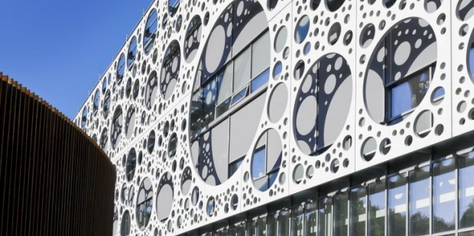
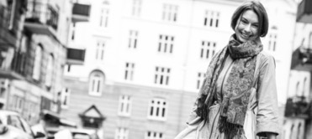
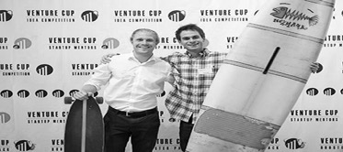
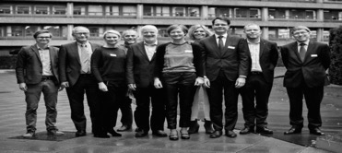
Three entries
→
→
→
Talent
InnoBooster
Grand Solutions
Notes:
We only have threee entrence points til IFD.
Talent is the individual level
Iværksettere, PhD, PostDoc
InnoBooster are for start-ups and smaller companies.
0,5 – 5 mio. DKK
SMV´er,
Op til 33% dækning
Grand Solutions are the bigger scientific projects
5 mio. DKK og op:
Tematiske og åbne
Typisk mellem virksomheder
og UNI/GTS.
Op til 75% dækning

Slide 6
How many succeed last year?
2017 | Success rate (%) | Applied amount (DKKm) | Investments (DKKm)
Grand Solutions | 15 | 4361 | 640
InnoBooster | 24 | 1129 | 267
Talent | 37 | 467 | 175
International | N/A | N/A | 252

Slide 7
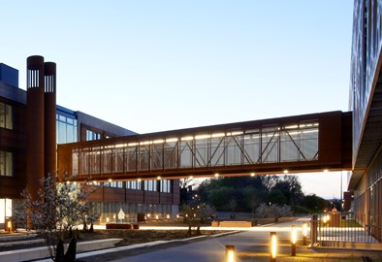
Grand Solutions
Ambitious, value creation, best team
Long-term perspectives
Any location in the innovation value chain, from TRL 1-2 and up
The right partners in the best team
Larger investments – typically 0.5 – 6m Euro
Ambitious, articulated risks - and makes a real difference

Slide 8
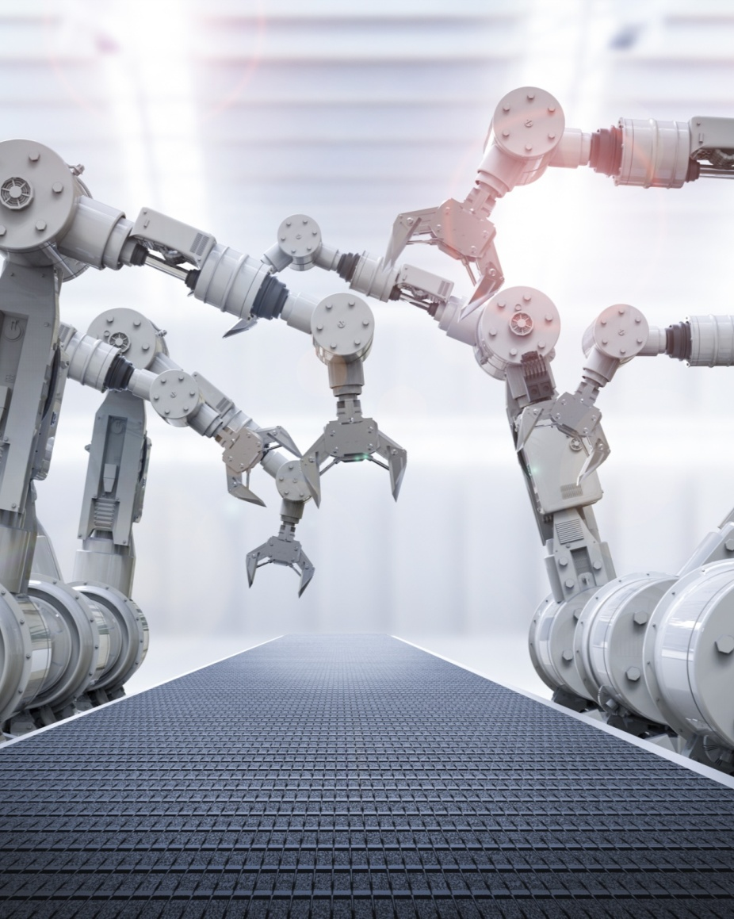



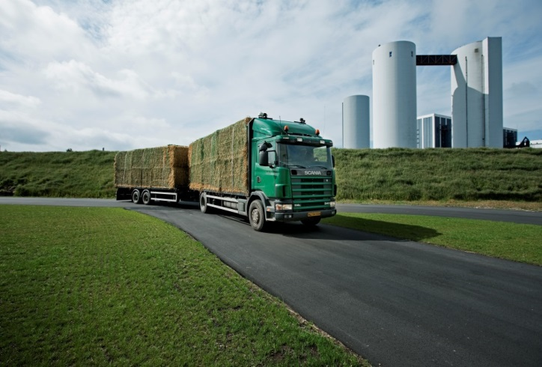
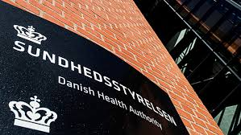

Grand Solutions
Typical partners
Universities & Hospitals
Danish and foreign
University Colleges Denmark
Companies
Small and large
Private and public
Danish and foreign
RTO´s (GTS)
Authorities
Regions and municipalities

Slide 9
Grand Solutions 2019 +DKK 700m Possible calls – awaiting ongoing fiscal law negotiations
Better Health and Clinical Research
Including e.g. a citizen-based and technology-supported health system, diagnostics, prevention, vaccines, microbiome, medico technologies, etc
New Technological Opportunities
Including e.g. cyber security, fintech, energy technology, digitalization/research center, drones/space, materials, industrial growth technologies, etc.
Green Growth
Including e.g. energy, climate, environment, organic food, aquaculture, circular economy, bioressources, AMR, microplastics etc.
New Thematic calls?
Open call

Slide 10
The Grand Solutions plan - 2019
New Tech Opportunities
Early
December
Medio
April
29. April -
16. may
Medio
June
February 19th
Better Health and Clinical Research
Green Growth
Deadline
Invitation
to interview
or rejection
Interview
Decision
Thematic
Calls
Other calls
Open Call
Ultimo
February
Ultimo
September
Ultimo
November
August 20th
October
New Tech Opportunities
Thematic calls
Open call
Deadline
Invitation
to interview
or rejection
Interview
Decision

Slide 11
Grand Solutions 2019 - Application scheme Basically the same as last year
Improvements:
More freedom
More logical flow
Watch out - Less guidance
Based on input from applicants and administrators gave a simplified budget scheme:
From half year to yearly budgets
Industrial/experimental ratio made more simple
+70% less typing of data
Same criteria as last year
QVEI:
Quality of innovation and research
Value creation
Efficiency
Implementation of results

Slide 12
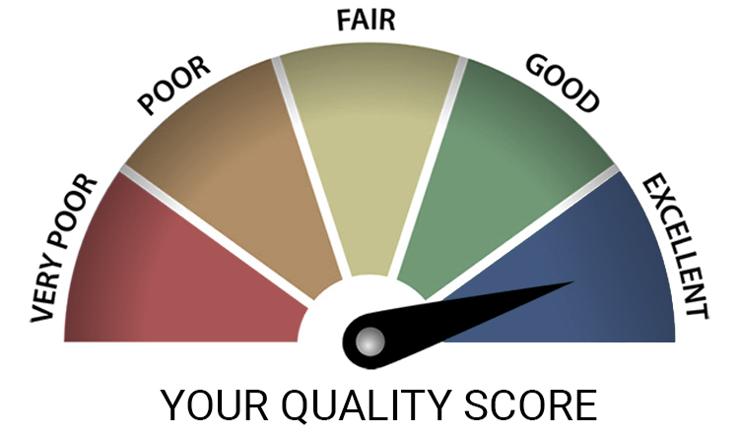
Grand Solutions 2019 – Q – as in Quality
Quality of Research & Innovation:
Need - level of pain?
Compared to State of the Art?
Why will you succeed?
Any IP issues?
Definition of ”Innovation”: The process af converting knowledge into value

Slide 13

Grand Solutions 2019 – V – as in Value Creation
Value creation:
Quantitative meassures
Value can be more than the direct monetary value (sales, profit or export)
Less enviromental footprint
More healthy lives
Reduces ressources, etc.

Slide 14

Grand Solutions 2019 – E – as in Efficiency
Efficiency in getting things done
Logical plan with workpackages
Focussed risk reduction
Clear milestones & quantitative deliverables
Use of proceeds (use of our money!)
Governance model
Project leader competencies

Slide 15

Grand Solutions 2019 – I – as in Implementation
Implementation:
Who will take over after the project ends?
Is the value creation and risk reduction enough for the next investor?
Others barriers for implementation?

Slide 16
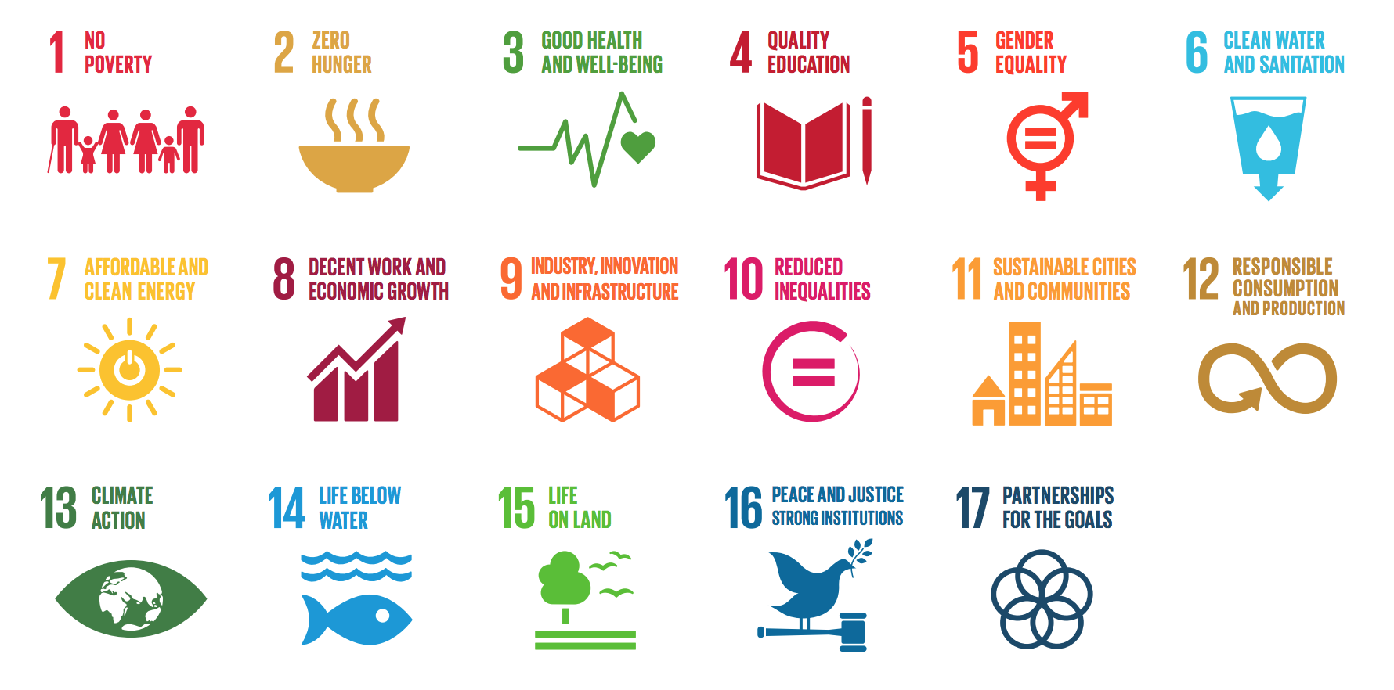

Slide 17
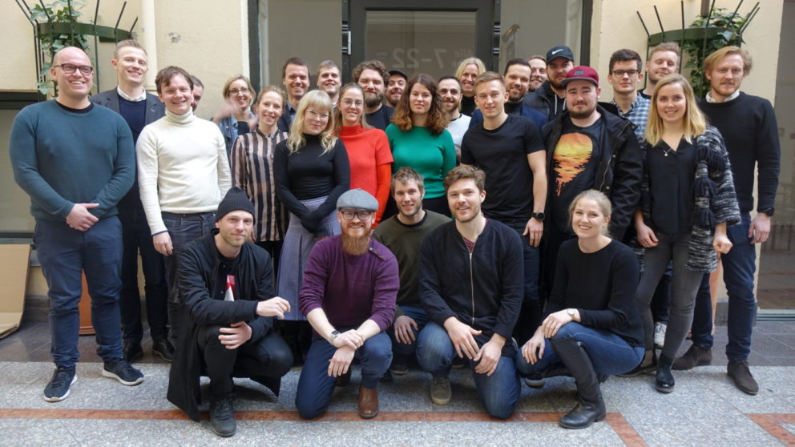
News – InnoFounder Experienced & Senior Industry Fellow
Notes:
InnoFounder: Next deadline November 15th 2018. Picture is a team of InnoFounders
Industrial Researchers (Ph.D. and Postdoc): Deadline: Januar 8th 2019

Slide 18

Proof-of-concept program: InnoExplorer – opening in 2019

Slide 19
InnoBooster - 2017
1763 applications
Succes: 26 %
Budget: DKK 300m

Slide 20
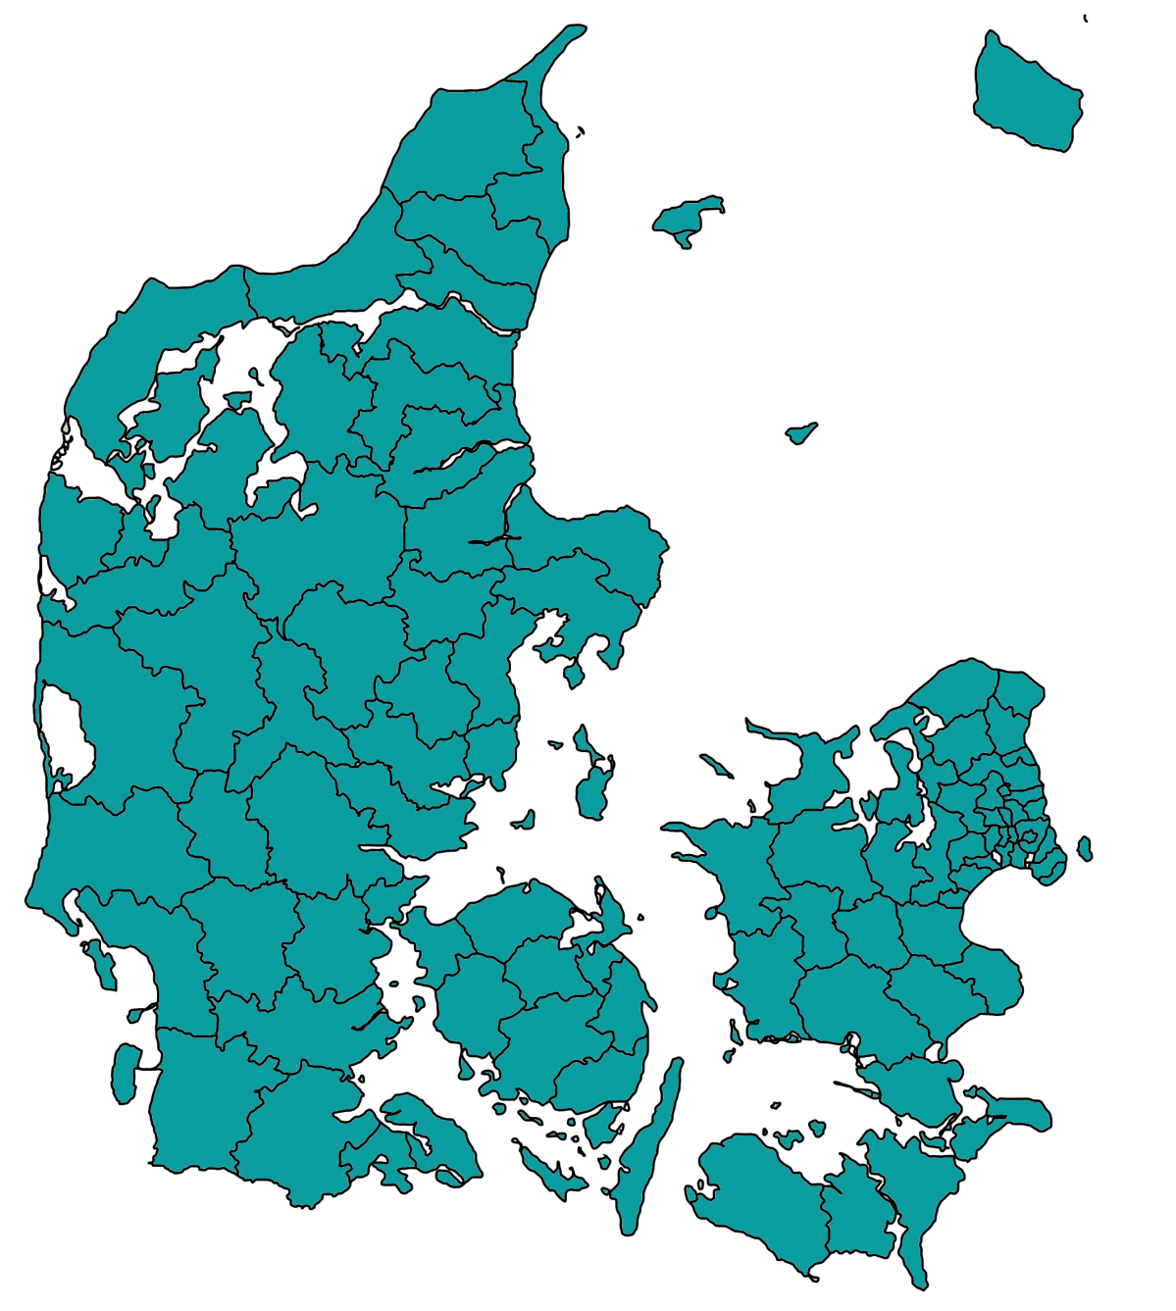
InnoBooster – high succesrate in Southern Denmark
112, 32%
The arrows mark increase or decrease in number and succesrate (compared to 2016)
327, 29%
997, 23%
208, 39%
120, 20%

Slide 21
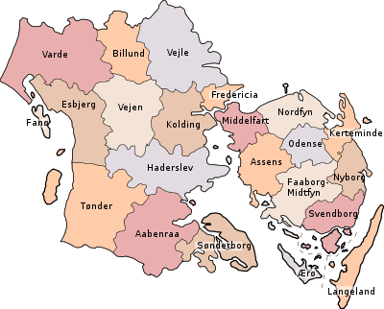
Number and succes of IB-applications in the municipalities
8; 25%
4; 25%
17; 41%
1; 100% %
15; 33%
7; 29%
8; 50%
0
13; 54%
24; 33%
Green arrow:
Increase since 2016
Red arrow:
Decrease since 2016
4; 25%
52; 38%
4; 0%
2; 50%
2; 0%
3; 33%
0
14; 36%
7; 57%
22; 50%
0
1; 100%
Notes:
Kerteminde og Odense: nogle mangler afgørelse.

Slide 22
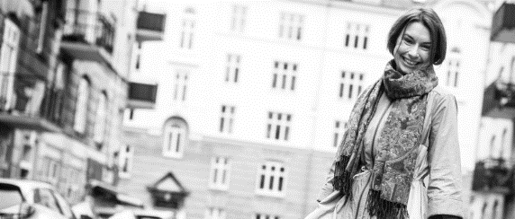
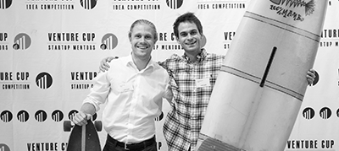
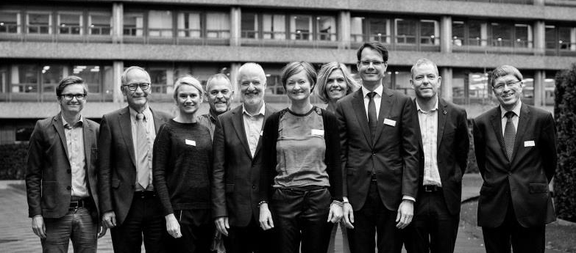
New opportunities in the innovation value chain
Basic research
Applied research
Development
Commercialisation & implementation
Senior Industry fellow
Talent
Innofounder Experienced
POC
InnoBooster
SMV’s
Grand Solutions
PPP’s
Notes:
Speakers Notes:
- We only have threee entrence points til IFD. - Talent is the individual level.
- InnoBooster are for start-ups and smaller companies.
- Grand Solution are the bigger scientific projects.

Slide 23
Platforms for international programmes
- JPI
- ERA-nets
- Art. 185 & 187 calls
- FET FLAGSHIP
- JTI
Horizon 2020/
Horizon Europe
- Globalstars calls
- EUREKA
- Eurostars – (art. 185)
EUREKA
- Digitalization public sector
- Energy
- Sustainable agriculture
- Nordic Permed (2018 call)
Bilaterale
programmes
NordForsk
- 10 prioritized countries

Slide 24
IFD budget: DKK 150-175m
2019-20 International calls - to be prioritized & approved
Bioresources
JPI AMR
DK - Brazil
Blue BioEconomy
Nordic Aqua Culture
Energy/Transport/Building
DK – India – Water & Energy
REGSYS SES
DK-China 2020-21
Nordisk EnergiForsk
RegSYS SES 18
JPI Ocean – Micro Plastic
DK – China 2019
DK-India 2020
Environment/Water
JPI Emergent Pollutants & AMR
Biodiversity and climate
Life sciences
JPND 2019
PermERA 2019
IMI Promotion
DK – Japan Tele/Robotic-Health
SSH
AAL SCP 2019
JPI Urban
NordForsk – Puclic Digitalization i
Advanced Technologies
Quantum Computing
Industry 4.0
Globalstars – Asia/USA
SME
Eurostars 10
Eurostars 11
Eurostars 12 - 2020
Notes:
Navne på projekter er tilfældige og har ingen relation til årets ansøgninger. Er kun for illustration.

Slide 25


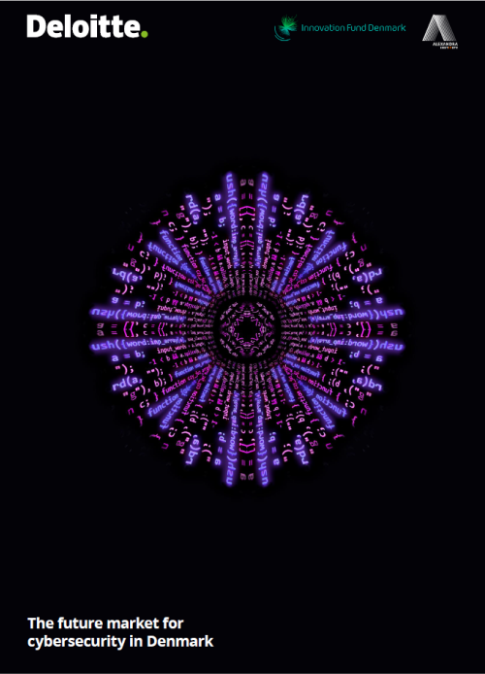


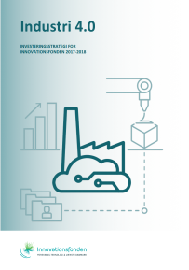



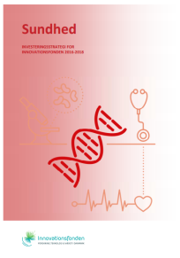

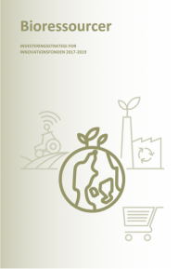
Spotting trends – investment strategies for major areas
2014 – 2017 konto 10 + 20

Slide 26
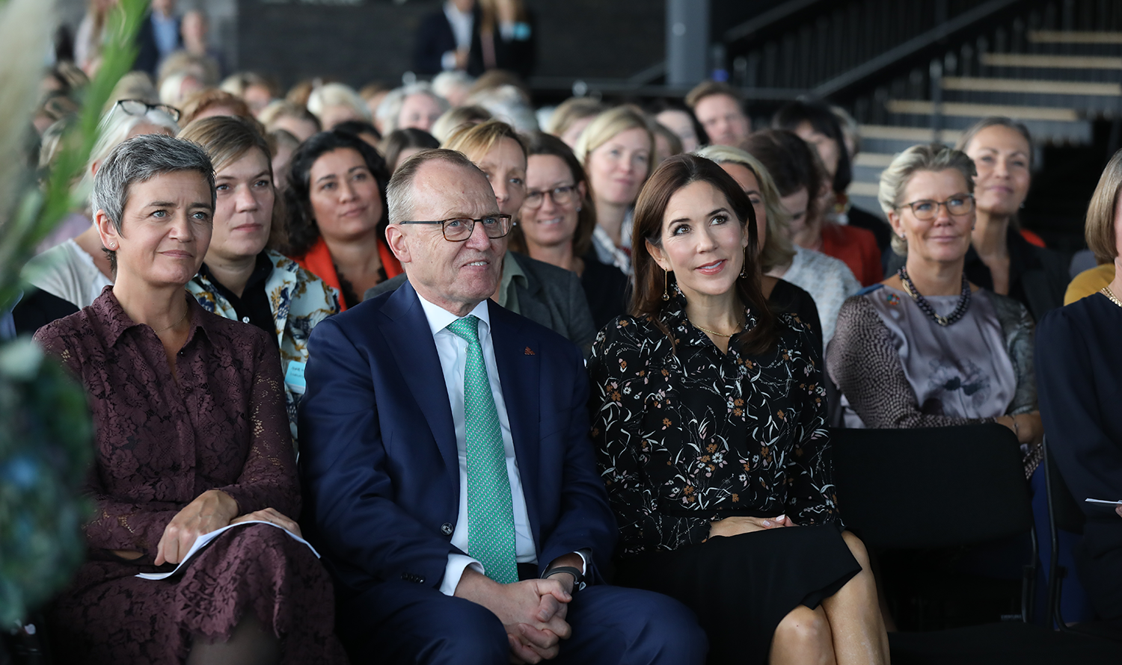
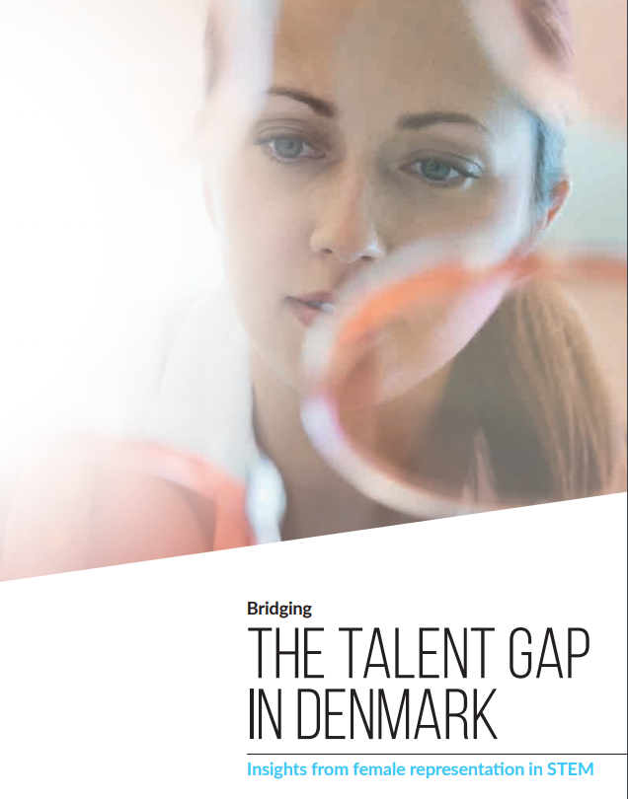

Slide 27
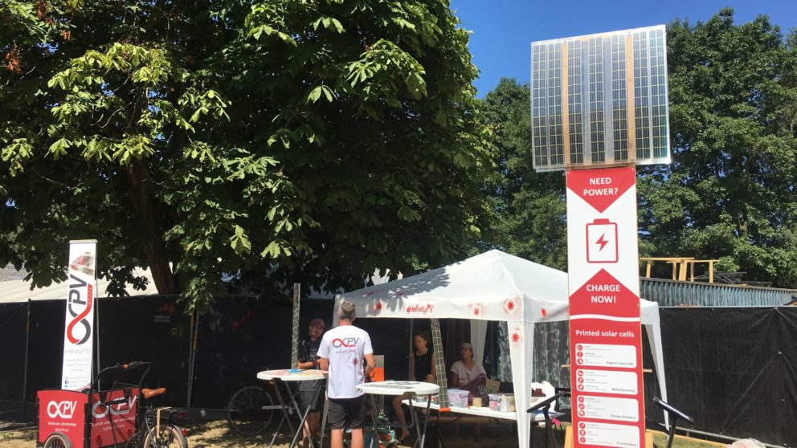
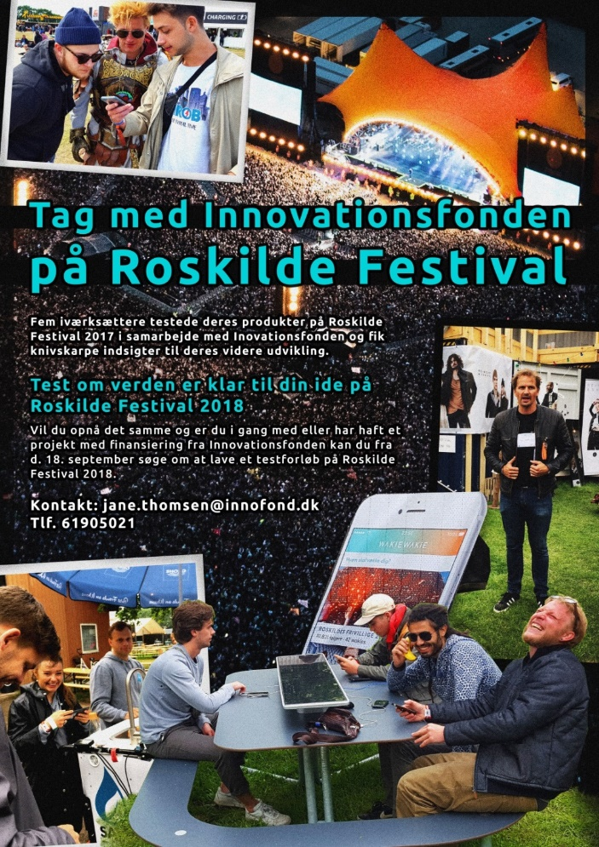

Slide 28

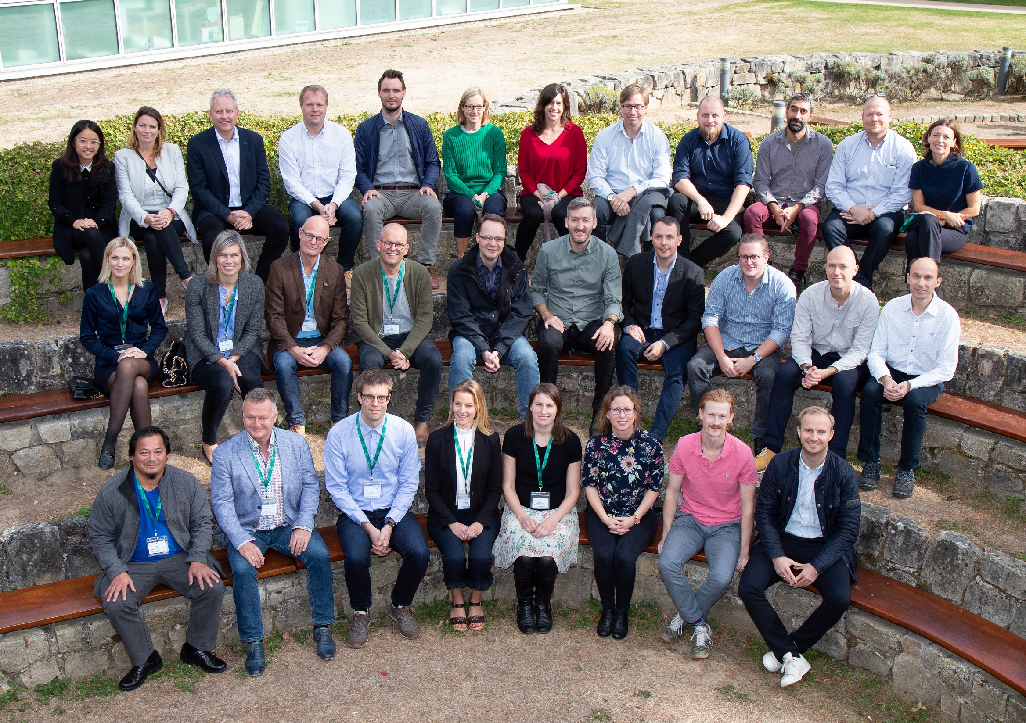
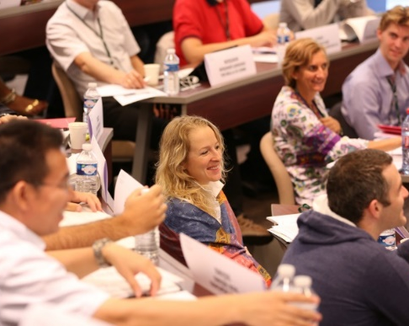
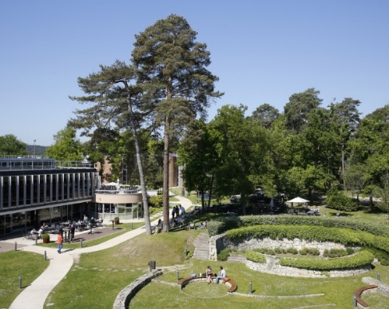

Making innovation happen
Notes:
To kvindelige deltagere fra SDU på det første INSEAD hold Grith Lykke og Natalia Lundquist
Making Innovation Happen er Innovationsfondens high level projektlederuddannelse, som udbydes sammen med INSEAD i Frankrig.
INSEAD business school ligger top 3 på verdensplan inden for executive lederuddannelse og INSEADs faculty er i absolut verdensklasse.
Making Innovation Happen giver fondens projektledere et vigtigt kompetenceløft inden for Personal Leadership, Enhanced Project Leadership Skills samt Business Understanding.
Innovationsfonden betaler deltagelse og materialer samt begge ophold på INSEAD i Frankrig. Deltagerne betaler selv for allokeret tid samt transportudgifter.
Der gennemføres to programmer om året for 30-32 deltagere. Deltagerne udvælges blandt fondens projekter - Grand Solutions, store InnoBooster-projekter og internationale projekter.
Deltagernes profiler er blandet fra hhv. universiteter, industri og start ups, hvilket understøtter deltagernes mulighed for at erfaringsdele og også lære af hinanden.
Grand Solution projekter fra 2018 inviteres til at deltage af deres investment manager. Næste proces løber fra oktober til november, hvor deltagere til 1. program i 2019 udvælges.
Deltagerne udvælges på baggrund af den værdi uddannelsen vil tilføre såvel projektet som den enkelte selv. Dette skal motiveres i en ansøgning til Innovationsfonden med frist 24. januar.
Det er afgørende, at man kan deltage i alle moduler:
Kick off, Kbh 8. april 2019
Modul 1, Frankrig 17.- 21. juni 2019
Modul 2, Frankrig 7. - 10. oktober 2019
Closing, Kbh 11. december 2019
Der gives besked om optagelse medio februar 2019.
Grith Lykke
University of Southern Denmark
DARE Therapeutics - developing a next generation treatment for wet AMD and DME
Wet age-related macular degeneration and diabetic macular edema are leading causes of blindness and present with great unmet medical needs. We will address these needs by maturing a novel therapeutic antibody for pharmaceutical development. Objectives are to expand proof of concept from rodents to non-human primate and confirm positive differentiation to current standard of care, increasing the value of the project. Work packages are distributed between a contract research organization, a UK collaborator and the inventor team at University of Southern Denmark. The project will enable informed decision at the next value infliction point. Our preferred option is the development of an end-product in venture-capital based spin-out company.
Natalia Lundquist
TEK Innovation, University of Southern Denmark
Future Freezing Unit
The project goal is to develop a price-competitive robotic freezer for cryopreservation of biological samples. This in-volves development of: 1) robotic functionality for manip-ulation of storage boxes and tubes at -86C, 2) highly reli-able software for secure management of the individual bi-ological sample, 3) a privacy-preserving big data interface for scientific work, and 4) a modular climate zone for opti-mizing cryopreservation of therapeutic cells. By project end, we will be able to provide healthcare providers, bi-obanks and pharmaceutical companies with a secure, low cost and modular solution for optimal storage of biological samples.

Slide 29
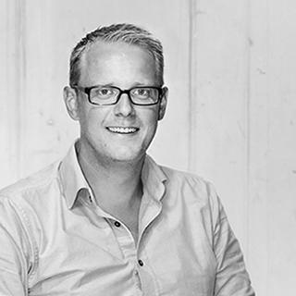
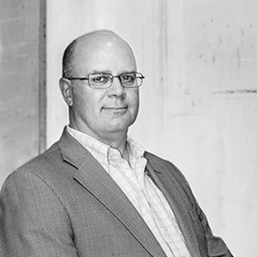
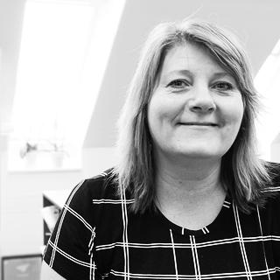
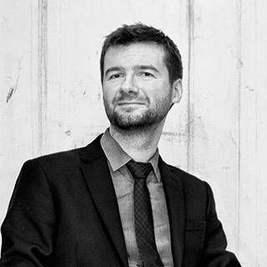
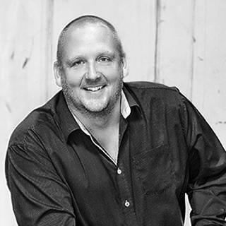
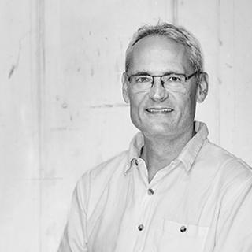
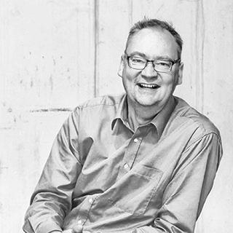
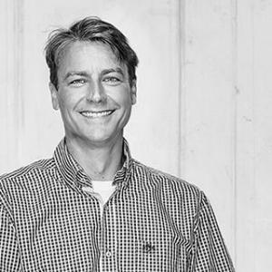
We are approaching the Q/A session
Lars Winther
Jakob Dahl Wedel

Slide 30
innovationsfonden.dk Newsletter: innovationsfonden.dk/nyhedsbreve Slides of today: innovationsfonden.dk/fonden2019

