Slide 1



Opportunities for your
research and innovation
EVP Tore Duvold, 23 November 2018

Slide 2
From science to value
1
2
3
AU Science
IFD-investment
Value
Notes:
Well-recognized research, education and innovation
National and international collaborations and talents
Scientific/innovative solutions to societal challenges
8 bn DKK active portefolio
1800 active projects
250 Int. projects
3300/yr project proposals
1.5 bn DKK in 2019

Slide 3

IFD Regional model – Aarhus as headquarter
Headquarter in Aarhus is under establishment
Odense, Aalborg and Copenhagen
Strengthening the regional presence across Denmark

Slide 4
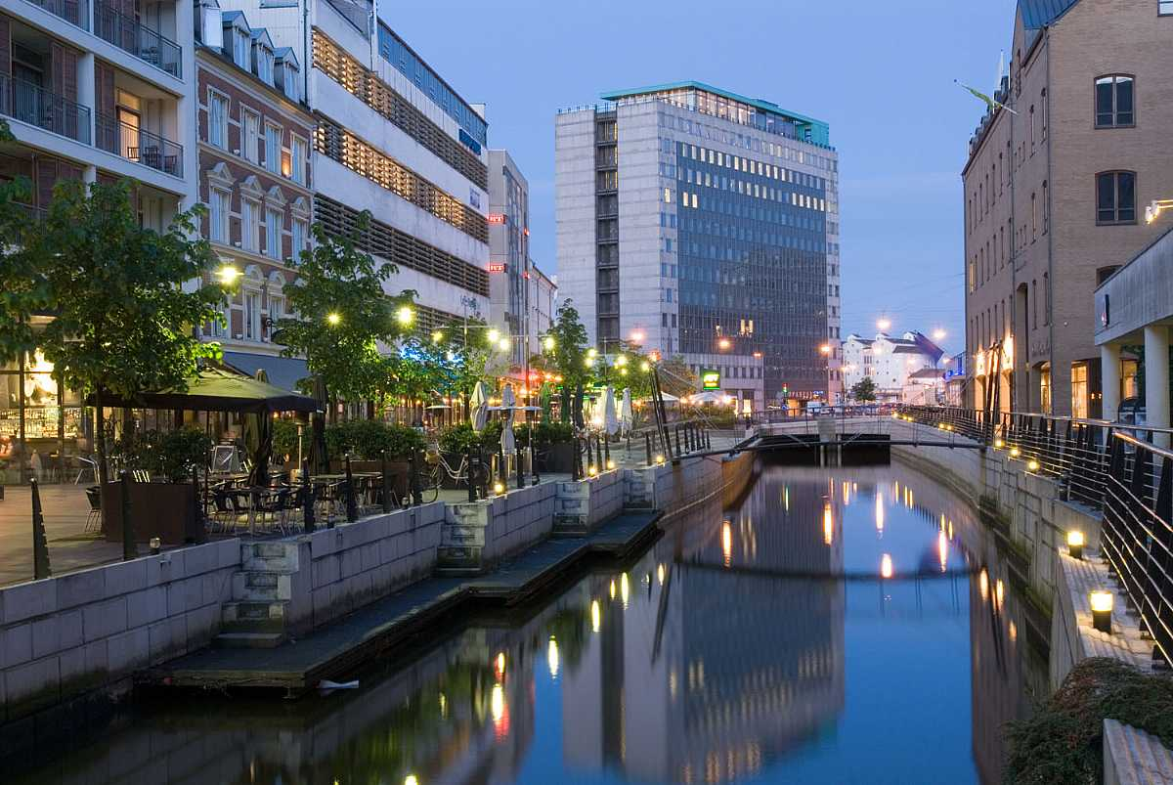

Slide 5
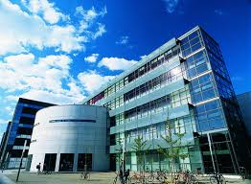

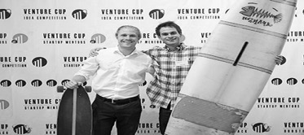
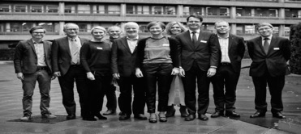
Three entries
→
→
→
Talent
InnoBooster
Grand Solutions
Notes:
We only have threee entrence points til IFD.
Talent is the individual level
Iværksettere, PhD, PostDoc
InnoBooster are for start-ups and smaller companies.
0,5 – 5 mio. DKK
SMV´er,
Op til 33% dækning
Grand Solutions are the bigger scientific projects
5 mio. DKK og op:
Tematiske og åbne
Typisk mellem virksomheder
og UNI/GTS.
Op til 75% dækning

Slide 6
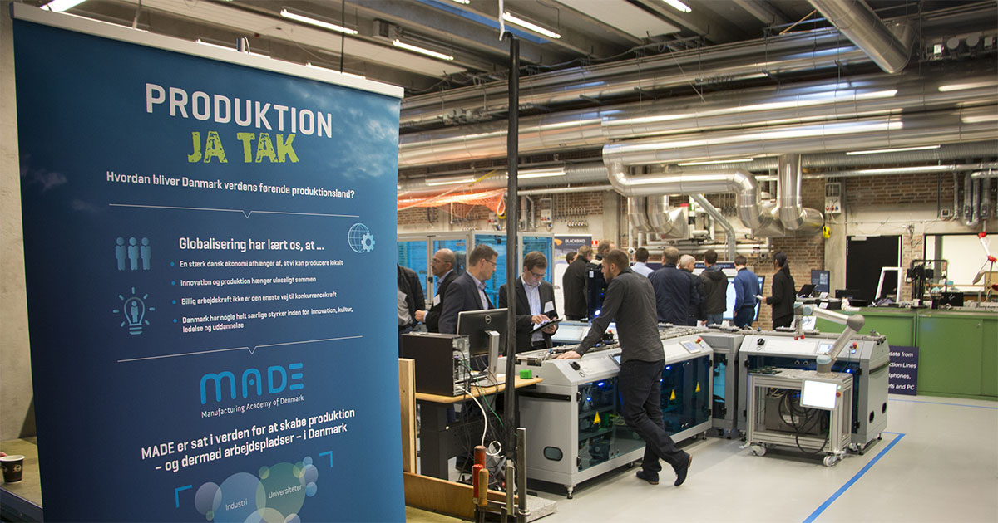

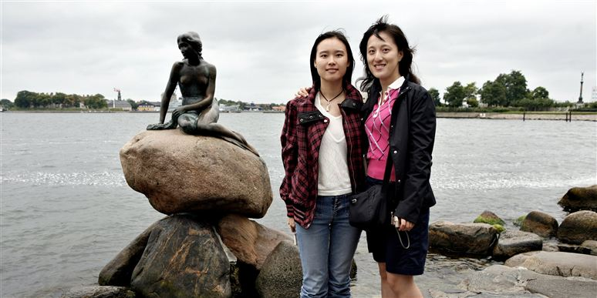
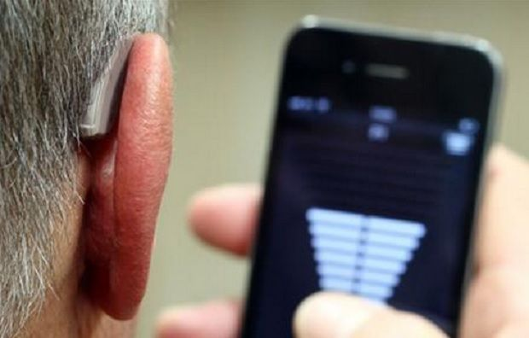
CBS and IFD
– value for our society
Notes:
Billede ØVERST TIL VENSTRE – MADE
CBS-Institut:
Institut for Strategi og Globalisering
Status:
Igangværende
Startdato:
25-04-2013
Slutdato:
01-01-2019
BILLEDE ØVERST TIL HØJRE
Bevillingsgiver:
Innovationsfonden/Grand Solutions
CBS Institut:
Department of Management, Society and Communication
Community Health Innovation: Exploring New Models for Better Preventive Care of Citizens at Risk (PRE+CARE)
Status:
Igangværende
Startdato:
01-01-2018
Slutdato:
30-11-2020
NEDERST TIL VENSTRE: UMAMI
Understanding Mindsets across Markets Internationally (UMAMI)
Projektet vil udforske, hvad der får kinesiske turister til at vælge eller fravælge Danmark og derefter udvikle en big-data platform, turisme produkter samt kommunikationsstrategier. Projektet har fire hovedfaser: Første fase undersøger hvad kinesiske turister efterspørger i Danmark. Anden fase benytter state-of-the-art attitude forskning og indhenter kvalitative og kvantitative data blandt kinesiske turister for at forstå detaljen i deres besøgsadfærd. Desuden udvikles der i fase 2 et sofistikeret selvlærende værktøj til at segmentere kinesiske turister. I tredje fase udvikles en big-data platform, hvis struktur og indhold er baseret på viden fra fase 1 og 2. I samarbejde med VisitNordsjælland og Carlsberg udvikles metoder for løbende indsamling af big data. Platformen optimeres og sættes op, så industripartnerne kan køre den videre ved projektets konklusion. Desuden udvikles der oplevelsesprodukter og kommunikationsstrategier på baggrund af den opnåede specialviden. Fjerde fase undersøger effekten af turisme for salget af danske produkter til turisternes oprindelsesland. Et mål med denne fase er at identificere hvordan turisme på bedst mulig måde kan benyttes til at øge salget af varer til turisternes oprindelsesland.
Type:
Public (National)
Bevillingsgiver:
Innovationsfonden/Grand Solutions
Institut:
Institut for Afsætningsøkonomi
Status:
Igangværende
Startdato:
02-01-2017
Slutdato:
31-12-2020
NEDERST TIL HØJRE
ErhvervsPh.D.: Talentudvikling i Hummel A/S (HUM/CBS)
Abstract:
ErhvervsPhD-projektet vil undersøge, hvad talent er i hummel, samt hvordan talentudvikling (TU) er bevidstgjort og praktiseres i hummel. Herudover vil det undersøges, hvorledes udvikling, implementering, effektuering og resultater af et TU-program i hummel vil se ud, med fokus på at hummel opnår organisatorisk effektivitet. Projektet vil også se på , hvordan andre virksomheder i den danske mode- og beklædningsbranche praktiserer TU, og hvad hummel kan lære heraf og vice verca.
Type:
Public (National)
Bevillingsgiver:
Innovationsfonden/Erhvervsph.d.
Institut:
Institut for Organisation
Status:
Igangværende
Startdato:
05-05-2014
Slutdato:
01-05-2018
NEDERST TIL HØJRE
Pricing Excellence at GN Industrial PhD (GN Store Nord)
Abstract:
The intention of this research project is to shed light on how firm’s pricing decisions are affected by pricing practices and its underlying pricing capabilities. In a broad sense, pricing is not only concerned with putting a price tag on a product, but it is to be seen as a rather complex setup of various interrelated components, such as price research, pricing methods and analytics, pricing strategies and tactics, price communication and negotiation, as well as price control and monitoring.
Type:
Public (National)
Funder:
Innovationsfonden/Erhvervsph.d.
Department:
Department of Operations Management
Status:
Current
Start Date:
10-12-2014
End Date:
10-12-2017

Slide 7

IFD also invests in groundbreaking research
INCOM - example
Recent IFD-investment (DKK 60m)
Transforms a strong Danish research tradition in telecom to approach grand challenges of our digitalization.
The internet is responsible for 10 % of worldwide electricity consumption.
Scaling up broadband solutions is getting increasingly difficult.
Notes:
TotalBudget er 100 mio. kr.
TRAFIKKEN PÅ INTERNETTET ER TUSINDDOBLET SIDEN ÅR 2000
Internettet er som et netværk af cykelstier, veje og motorveje, hvor data bevæger sig selvstændigt rundt. Forestiller man sig, at antallet af disse stiger med over 25 % om året, uden at infrastrukturen udbygges tilsvarende, er det ikke svært at forestille sig, at der meget hurtigt opstår trængselsproblemer og kødannelse.
Med Internet of Things, Industri 4.0 og det hastigt stigende antal af online applikationer som medicinsk diagnostik, selvkørende biler og cloud-services vil internettrafikken - og dermed også det kolossale energibrug, der skal drive internettet - kun fortsætte opad.
Vi er gået fra simpel kommunikation, der forbandt huse og hjem via fastnettelefoner, til kraftige mobile enheder, der forbinder mennesker i bevægelse med tale og data, til nu oveni at forbinde ting i et Internet of Things, hvor ting og maskiner kommunikerer med hinanden. Den del vokser med mere end 30 % årligt og forventes i 2020 at forbinde mere end 20 mia. enheder. Al den kommunikation foregår også via internettet.
Alt dette bruger enorme mængder energi, vi løber snart tør for plads i infrastrukturen, og sikkerheden er et stadigt stigende fokusområde. Det kræver alt sammen ny teknologi.
I et nyt treårigt Grand Solutions-projekt til 100 mio. kr., som er støttet af Innovationsfonden med 60 mio., samles DTU, Aarhus Universitet og 12 danske virksomheder. Projektet hedder INCOM og har til opgave at skabe nye løsninger til den næste generation af kommunikationsinfrastruktur. Projektet har herudover mere end 15 associerede partnere, hvoraf hovedparten kommer fra industrien.
- Det er nok de færreste, der ved, at alle de trådløse forbindelser, vi i dag bruger så flittigt, i virkeligheden kun er trådløse det første korte stykke vej. Herefter bæres trafikken i kablede optiske forbindelser på kryds og tværs gennem lande og under oceaner. Det er her, INCOM kommer ind i billedet, for verden har akut behov for at gøre de forbindelser stærkere og grønnere, siger professor Leif Katsuo Oxenløwe fra DTU Fotonik, som er idémand bag det nye Innovationsfondsprojekt.
Informationsalderens knudepunkter er datacentre, som er forbundet af interkontinentale optiske kabler, der med høj hastighed transmitterer information fra maskine til maskine og fra menneske til menneske - på bare 30 år er halvdelen af verdens befolkning blevet forbundet til internettet.
Udviklingen kommer dog ikke uden en stor energiregning. Den globale kommunikation forbruger så meget energi, at den udleder over 2 % af al menneskeskabt CO2, og datatrafikken stiger årligt med over 25 %. Kravene til den nye infrastruktur er derfor primært, at den skal levere meget større kapacitet med et markant lavere energiforbrug. Hertil kommer en større grad af pålidelighed, minimale forsinkelser og øget sikkerhed.
INCOM vil bl.a. gøre det muligt at reducere antallet af lyskilder til at drive internettet ved at forfine en såkaldt ”frekvenskam”, således at én laser kan erstatte adskillige hundrede lasere. Det giver en stor effektbesparelse i hele nettet og i datacentrene og kan samtidigt give øgede datahastigheder på mere end 400 GBit/s. INCOM arbejder også med at integrere kredsløb for lys på en chip, der for alvor vil reducere prisen og effektforbruget, idet meget af den signalbehandling, der nu foregår elektrisk, kan laves direkte i det optiske domæne. Energiforbruget til at konvertere fra lys til elektricitet fjernes altså helt.
- I løbet af de seneste år har vi etableret Aarhus Universitet som et center for fotonisk integration, der forbinder danske slutbrugere med europæiske tech-platforme. Sammen med vores projektpartnere vil vi bringe denne teknologi tættere på markedet. Samtidig vil vi i INCOM-projektet undersøge og implementere nye, simple, energieffektive og skalérbare end-to-end sikkerhedsordninger på tværs af IoT-infrastrukturen, siger lektor Martijn Heck fra Institut for Ingeniørvidenskab, Aarhus Universitet.
Den kombinerede effekt af det stabile danske samfund med en stærk infrastruktur på tele, data og grøn energi tiltrækker store datacentre og et stigende antal højkapacitets interkontinentale søkabler. En fortsat stærk dansk position og vækst på dette meget konkurrencebetonede marked kræver en stor og risikofyldt indsats. Det gør sig især gældende i industrier, der har behov for tidligt at kunne tage innovative løsninger fra universiteterne og bringe dem ud til markedet i form af nye produkter og services.
Behovet for at bygge ny infrastruktur med energirigtige bredbåndsløsninger rummer store muligheder. Danske universiteter har stor ekspertise netop på de rette tekniske områder, og danske virksomheder er klar til at tage de nye teknologier og bringe dem på verdensmarkedet. INCOMs formål er at gøre dette muligt og herved skabe vækst i industrien. Således forventer hver af de deltagende virksomheder 5 år efter et vellykket INCOM-projekt at have øge deres årlige omsætning fra få til adskillige hundrede mio. kr. og øge deres samlede beskæftigelse med omkring 100 jobs.
- Ny teknologi kan hjælpe os med at løse en lang række konkrete udfordringer og skabe et bedre samfund, men det kræver også store mængder energi. Det her er et spændende projekt, da det er helt afgørende, at vi får gjort den digitale infrastruktur mere energieffektiv, siger Uddannelses- og Forskningsminister Tommy Ahlers.

Slide 8
How many succeeded last year?
2017 | Success rate (%) | Applied amount (DKKm) | Investments (DKKm)
Grand Solutions | 15 | 4361 | 640
InnoBooster | 24 | 1129 | 267
Talent | 37 | 467 | 175
International | N/A | N/A | 252

Slide 9
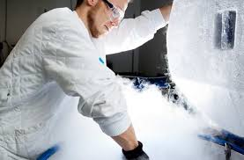
Grand Solutions
Ambitious, value creation, best team
Long-term perspectives
Any location in the innovation value chain, from TRL 1-2 and up
The right partners in the best team
Larger investments – typically 0.5 – 6m Euro
Ambitious, articulated risks - and makes a real difference

Slide 10




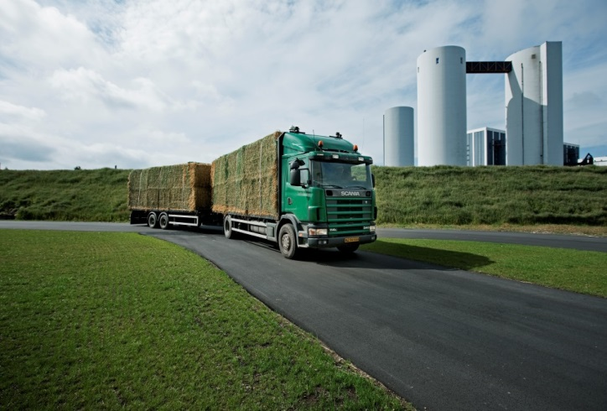


Grand Solutions
Typical partners
Universities & Hospitals
Danish and foreign
University Colleges Denmark
Companies
Small and large
Private and public
Danish and foreign
RTO´s (GTS)
Authorities
Regions and municipalities

Slide 11
Grand Solutions 2019 + DKK 700m Pending fiscal law approval
Better Health
E.g. psychiatry, antimicrobial resistance, diagnostics, PerMed, prevention, vaccines, microbiome, medico technologies, etc
Including a citizen-based and technology-supported health care system.
New Technological Opportunities
Also e.g. cyber security, fintech, energy technology, digitalization, IoT, AI, BlockChain, Big Data, Quantum technologies, Industri 4.0, drones/space, soft and hard materials, bio and life science, industrial growth technologies, reduced physical work load, etc.
Green Growth
E.g. energy, climate, environment, agriculture greenhouse gas reduction, intelligent food production, efficient transport, aquaculture, circular economy, bio/marine ressources, AMR, microplastics etc.
A national digitalization research center (100 mio. DKK)
Open call
Notes:
Opdateret med særcall på borgernær sundheds løsninger og digitaliserings center
Tal baseret KUN på fordeling af forsknings reserven – yderligere midler fra finanslov er på vej – men ikke vedtaget endnu.

Slide 12
The Grand Solutions plan - 2019
New Tech Opportunities
Early
December
Medio
April
29. April -
16. may
Medio
June
February 19th
Better Health and Clinical Research
Green Growth
Deadline
Invitation
to interview
or rejection
Interview
Decision
Thematic
Calls
Other calls
Open Call
Ultimo
February
Ultimo
September
Ultimo
November
August 20th
October
New Tech Opportunities
Thematic calls
Open call
Deadline
Invitation
to interview
or rejection
Interview
Decision

Slide 13
Grand Solutions 2019 - Application scheme Basically the same as last year
Improvements:
More freedom
More logical flow
Watch out - Less guidance
Based on input from applicants and administrators gave a simplified budget scheme:
From half year to yearly budgets
Industrial/experimental ratio made more simple
+70% less typing of data
Same criteria as last year
QVEI:
Quality of innovation and research
Value creation
Efficiency
Implementation of results

Slide 14
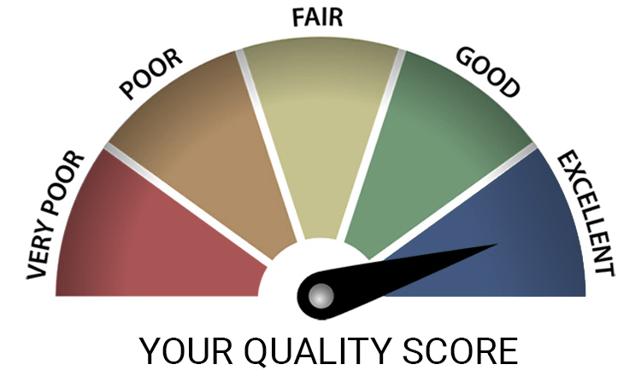
Grand Solutions 2019 – Q – as in Quality
Quality of Research & Innovation:
Need - level of pain?
Compared to State of the Art?
Why will you succeed?
Any IP issues?
Definition of ”Innovation”: The process af converting knowledge into value

Slide 15

Grand Solutions 2019 – V – as in Value Creation
Value creation:
Quantitative meassures
Value can be more than the direct monetary value (sales, profit or export)
Less enviromental footprint
More healthy lives
Reduces ressources, etc.

Slide 16

Grand Solutions 2019 – E – as in Efficiency
Efficiency in getting things done
Logical plan with workpackages
Focussed risk reduction
Clear milestones & quantitative deliverables
Use of proceeds (use of our money!)
Governance model
Project leader competencies

Slide 17

Grand Solutions 2019 – I – as in Implementation
Implementation:
Who will take over after the project ends?
Is the value creation and risk reduction enough for the next investor?
Others barriers for implementation?

Slide 18


Slide 19


DIVERSITY
by. PhD, Susanne Justesen
INNOVERSITY CPH
Innovationsfonden
Den 9. november 2018

Slide 20
THREE IMPORTANT TAKE-AWAYS
Diversity strengthens problem solving and financial performance in groups (=> better projects)
Homogeneity in groups poses a serious threat to research quality and research impact
Avoid more than 70% homogeneity in groups
46
2018 © INNOVERSITY COPENHAGEN

Slide 21
SUSANNE JUSTESEN
2012 - External lecturer in Innovation Management, CBS
2004 - 07 Ph.D. Studies at CBS + Visiting Scholar Stanford University
2002 - 03 Innoversity NEW YORK
2001 - Innoversity CPH
2000 MSc (Economy and Business) in Intercultural Management (CBS)
2

Slide 22
DIVERSITY - WHY?
Relevant to scientific research and innovation
Helps us understand problems in different ways
And discover completely new and different solutions
THE TWO PHASES OF
PROBLEM SOLVING
UNDERSTANDING THE PROBLEM
PREFERRED
SOLUTION
46
2018 © INNOVERSITY COPENHAGEN
Notes:
Especially complex problems - AND none the least: RESEARCH problems!

Slide 23
DIVERSITY INCREASES SCIENTIFIC IMPACT
According to new research
Cultural diversity amongst co-authors is seen to significantly boost research impact - up to 55% more citations - as documented in analysis of 9.000.000 scientific papers (AlShebli et al., 2018)
Gender diversity => Higher research quality, due to DIFFERENT methods applied and DIFFERENT research questions posed (Wullum-Nielsen et al.,2018)
46
2018 © INNOVERSITY COPENHAGEN
Notes:
Impact = number of citations received within five years of publication

Slide 24
DIVERSITY => FINANCIAL PERFORMANCE
Why Diversity Matters
Companies with the most gender diversity (Top 25%) in their executive leadership teams were more likely to outperform on profitability (21%) and value creation (27%)
McKinsey study of 1000 companies in 12 countries (2018)
46
2018 © INNOVERSITY COPENHAGEN
Notes:
McKinsey measured profitability by average EBIT margin and value creation by economic profit (EP) margin
EBIT: Earnings before interests and taxes

Slide 25
WHAT IS A DIFFERENCE? A knowledge domain
PERSPECTIVES: A particular way of under-standing a particular situation or problem
HEURISTICS: A particular preference in terms of how the problem should best be solved
A unique set of:
PERSPECTIVES
and
HEURISTICS
48
2018 © INNOVERSITY COPENHAGEN

Slide 26
EXAMPLES OF KNOWLEDGE DOMAINS
Novozymes
Male
Female
Copenhagen
Business School
Generation Y
(1981 - 1996)
Generation X
(1965-1980)
Denmark
Molecular
biology
Business
Development
China
50
2018 © INNOVERSITY COPENHAGEN

Slide 27
BUT UNFORTUNATELY, ALL TOO OFTEN! Homogeneity
WHEN WE COLLABORATE WITH OTHERS IN GROUPS - OFTEN, A FEW KNOWLEDGE DOMAINS ARE ALLOWED TO DOMINATE (HOMOGENEITY) =>
Limited search for information
Limited discussion of alternatives
Faulty decision-making and biased problem solving
and that is because…
Group relations become more important than the result (R vs R)
AVAILABILITY of knowledge domains ≠ USE
2018 © INNOVERSITY COPENHAGEN

Slide 28

FIVE LEVELS OF DIVERSITY
Diversity impacts innovation capacity at each level
Availability ≠ Use
Individual
diversity
Advisory network
Group diversity
Organisational diversity
External diversity
The whole company
Across national sites, units and departments
2018 © INNOVERSITY COPENHAGEN
External diversity
Customers & stakeholders
The city
Your local and regional area
The country
The national level
Globally
The international level
2014 © INNOVERSITY COPENHAGEN
Notes:
“Hidden knowledge” (lowest common denominator)

Slide 29

MAX 70% HOMOGENEITY
When composing groups and teams
A study from ISS in 2011: Non-homogeneous groups (120 / 469) had a 3,7 %-point higher revenue (succes) than the homogenous teams.
Similar to study by Herring (2009) which documented that a 1% increase in diversity => 9% increase in revenues
A non-homogenous group can be defined as a group of min 5 persons, that abide to the Max 70 % homogeneity-rule, eg:
Max 70% of team members with same gender
Max 70% of team members with the same nationality
Max 70% of team members with the same generation
2018 © INNOVERSITY CPH

Slide 30

GENDER DIVERSITY LEADS TO BETTER SCIENCE
Avoid gender homogeneity
Diversity in research methods applied AND research questions posed => Higher research QUALITY (Wullum Nielsen et al, 2018)
An analysis of 60 research teams (500 scientists and engineers) documented how women more accurately recognize AND promote the expertise of fellow team members (Joshi, 2014) => improved DISCOVERY
Gender diversity is thus paramount in ensuring that AVAILABLE diversity is also being USED
Notes:
This is why most of the larger EU research programs will REQUIRE you to have not only cultural diversity (for instance five different EU countries), but also gender diversity in your research project….

Slide 31
EN VIDENBASERET DEFINITION
ADGANG TIL OG BRUG AF FLERE VIDENDOMÆNER –
SAMTIDIG
47

Slide 32

DIVERSITY TRIUMPS ABILITY
Page, S. (2008, 2017)
Large study first published in Nature in 2008 (with Hong)
Everyone had their IQ measured => three groups [High performers]; [Medium performers] and [Low performers]
Asked to solve a complex problem in different groups - competing against each other
The mixed groups outperformed the high performers EVERY time (50 times), why?
2018 © INNOVERSITY COPENHAGEN
Notes:
According to Page (2008) the explanation is that when one agent gets stuck, there is always someone else able to come up with a different / better method. Top performers tend to have only ONE solution

Slide 33
A FEW RECOMMENDATIONS When composing your next research group
If you want to ensure research IMPACT and QUALITY, make sure that your research group is diverse, especially in terms of gender & culture
Remember the Max 70% Homogeneity Rule for group composition in your next research project
BEWARE: Group homogeneity => reproduction and NOT innovation
2018 © INNOVERSITY COPENHAGEN

Slide 34
THANK YOU!
Feel free to contact me with comments or questions
Ph.D. Susanne Justesen
INNOVERSITY CPH
susanne@innoversity.dk
Tlf: (+45) 3113 1616

Slide 35
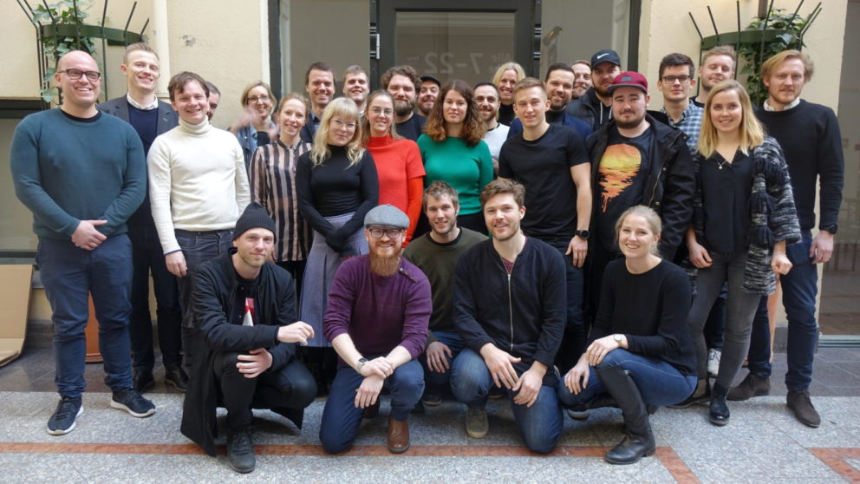
News – InnoFounder Experienced & Industrial Fellow
Notes:
InnoFounder: Next deadline November 15th 2018. Picture is a team of InnoFounders
Industrial Researchers (Ph.D. and Postdoc): Deadline: Januar 8th 2019

Slide 36
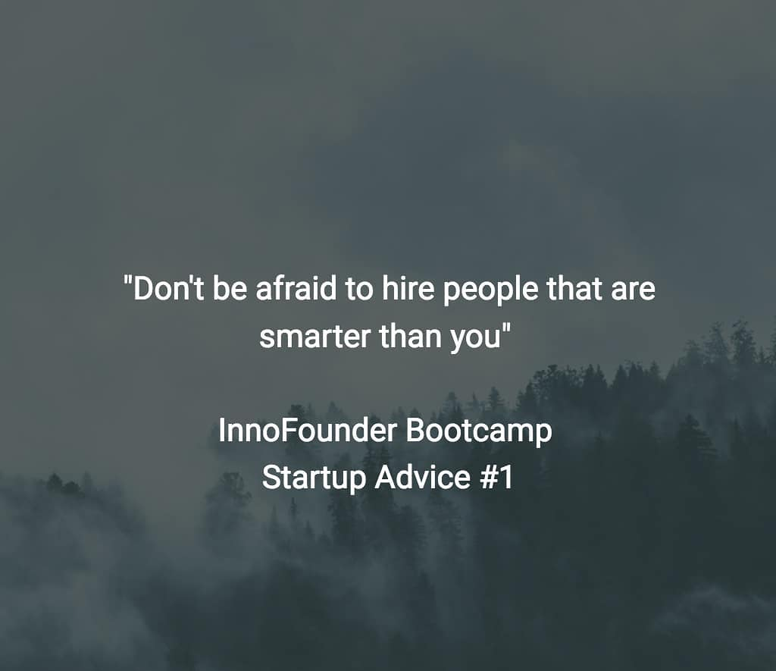
InnoFounder Experienced
Significant professional work-experience
Entrepreneurs will receive:
Monthly grant of DKK 30,000 for a 12 month period
A special grant of DKK 100,000 to cover up-front finance
Entrepreneurs will be followed to identify the need for knowledge, sparring and network
Social impact matter

Slide 37

Industrial Fellow
Company and university collaboration + highly skilled researcher
The researcher is temporarily employed (part time or full time) in the other organisation
Duration between ½-2 years
IFD finances salary and other project related expenses
Senior Industry Fellow

Slide 38

InnoExplorer – opening in 2019

Slide 39
InnoExplorer
Results and technologies developed at universities, hospitals and university colleges.
InnoExplorer can allocate funding for researchers' wages, relevant services and materials and overhead.
Application: DKK 0.5-1.5m from IFD.
The projects can last up to one year.

Slide 40
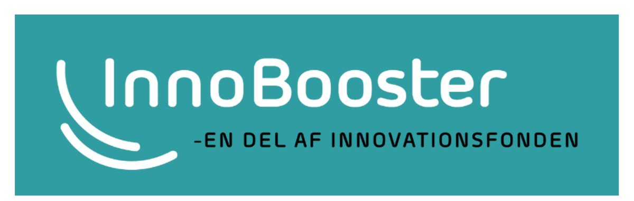
50.000 – 5 mio. DKK
for innovative startup´s and SME´s

Slide 41
InnoBooster - 2017
1763 applications
Succes: 26 %
Budget: DKK 300m

Slide 42
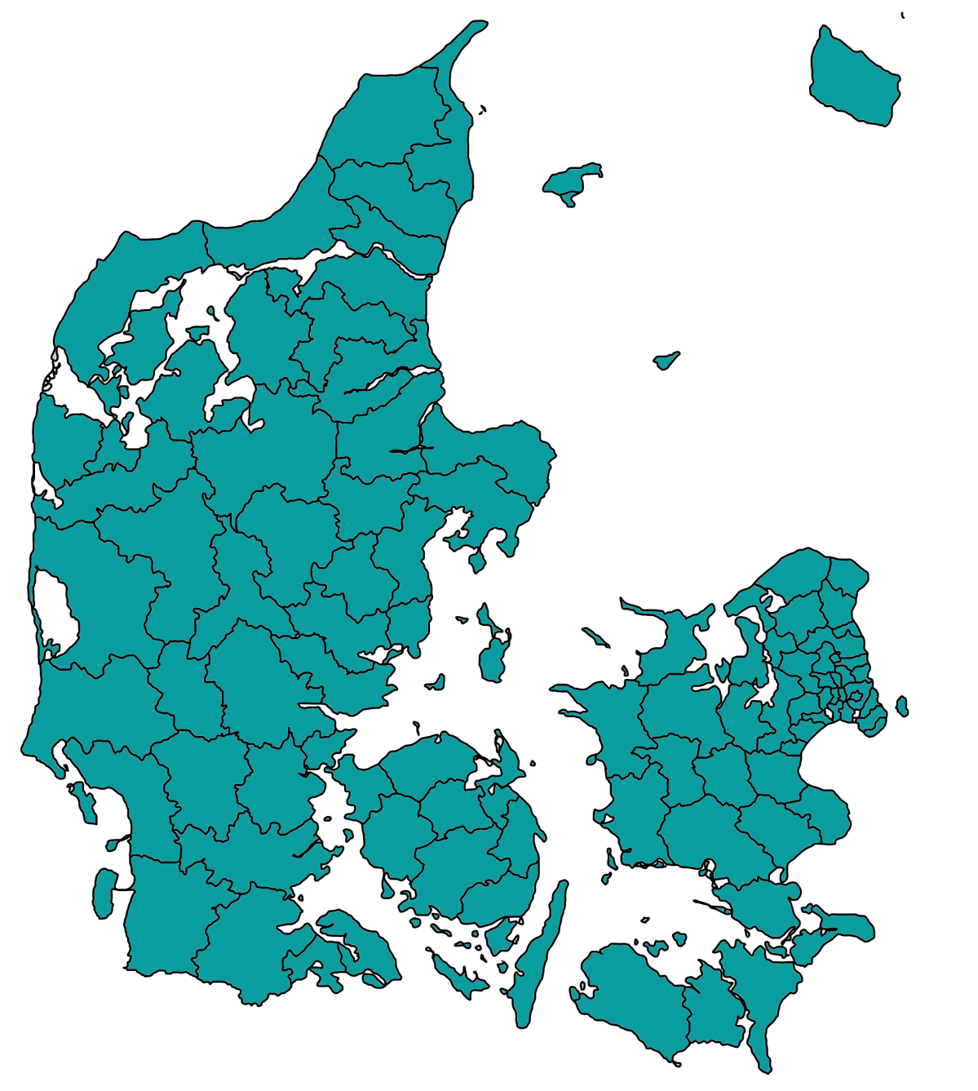
InnoBooster – activity from Central Denmark Region
112, 32%
The arrows mark increase or decrease in number and succesrate (compared to 2016)
327, 29%
997, 23%
208, 39%
120, 20%

Slide 43
Platforms for international programmes
- JPI
- ERA-nets
- Art. 185 & 187 calls
- FET FLAGSHIP
- JTI
Horizon 2020/
Horizon Europe
- Globalstars calls
- EUREKA
- Eurostars – (art. 185)
EUREKA
- Digitalization public sector
- Energy
- Sustainable aquaculture
- Nordic Permed (2018 call)
Bilaterale
programmes
NordForsk
- 10 prioritized countries

Slide 44
IFD budget: DKK 150-175m
2019-20 International calls - to be prioritized & approved
Bioresources
JPI AMR
DK - Brazil
Blue BioEconomy
Nordic Aqua Culture
Energy/Transport/Building
DK – India – Water & Energy
REGSYS SES
DK-China 2020-21
Nordisk EnergiForsk
RegSYS SES 18
JPI Ocean – Micro Plastic
DK – China 2019
DK-India 2020
Environment/Water
JPI Emergent Pollutants & AMR
Biodiversity and climate
Life sciences
JPND 2019
PermERA 2019
IMI Promotion
DK – Japan Tele/Robotic-Health
SSH
AAL SCP 2019
JPI Urban
NordForsk – Puclic Digitalization i
Advanced Technologies
Quantum Computing
Industry 4.0
Globalstars – Asia/USA
SME
Eurostars 10
Eurostars 11
Eurostars 12 - 2020
Notes:
Navne på projekter er tilfældige og har ingen relation til årets ansøgninger. Er kun for illustration.

Slide 45


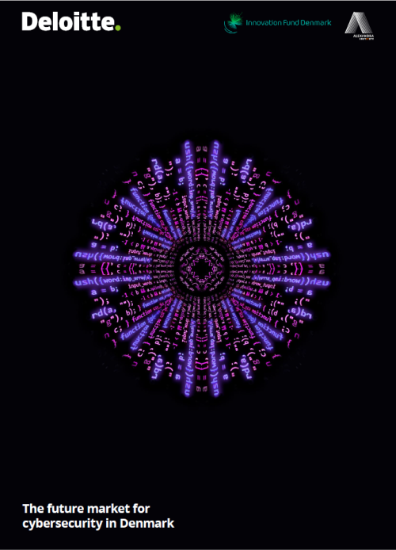


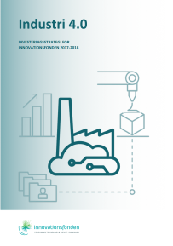





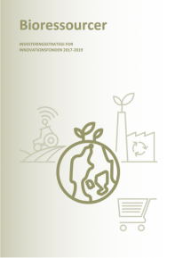
Spotting trends – investment strategies for major areas
2014 – 2017 konto 10 + 20

Slide 46
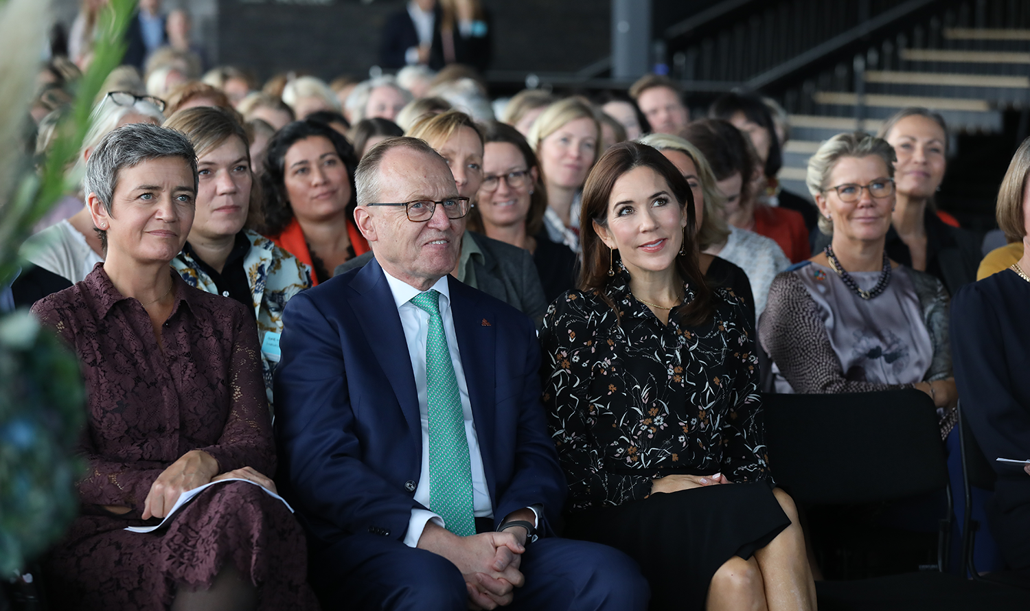
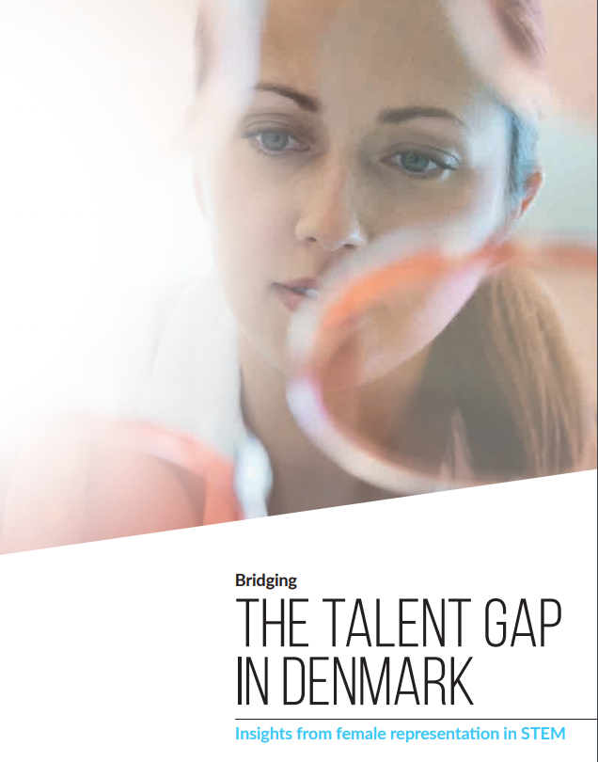

Slide 47
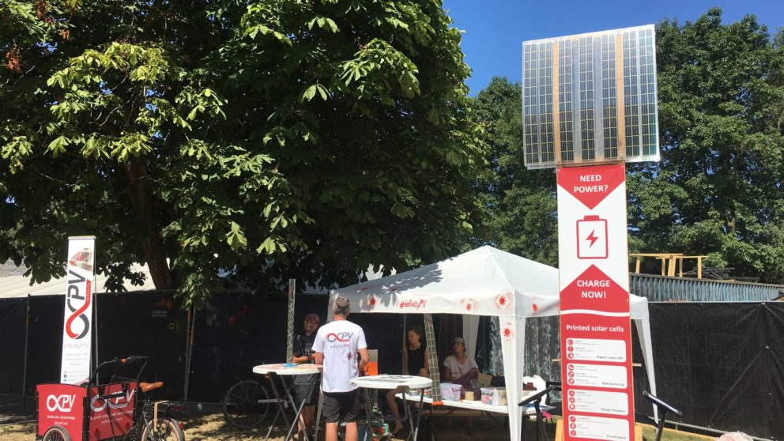
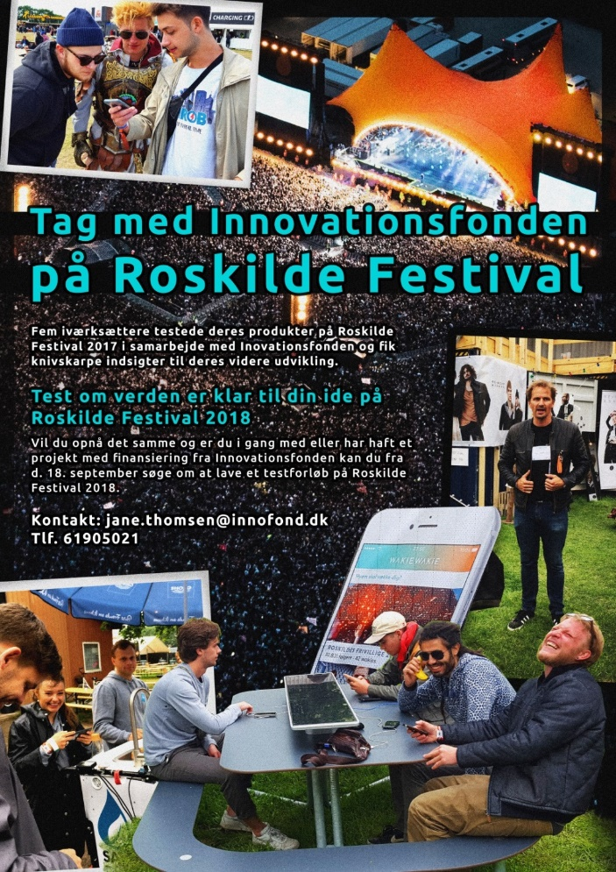

Slide 48

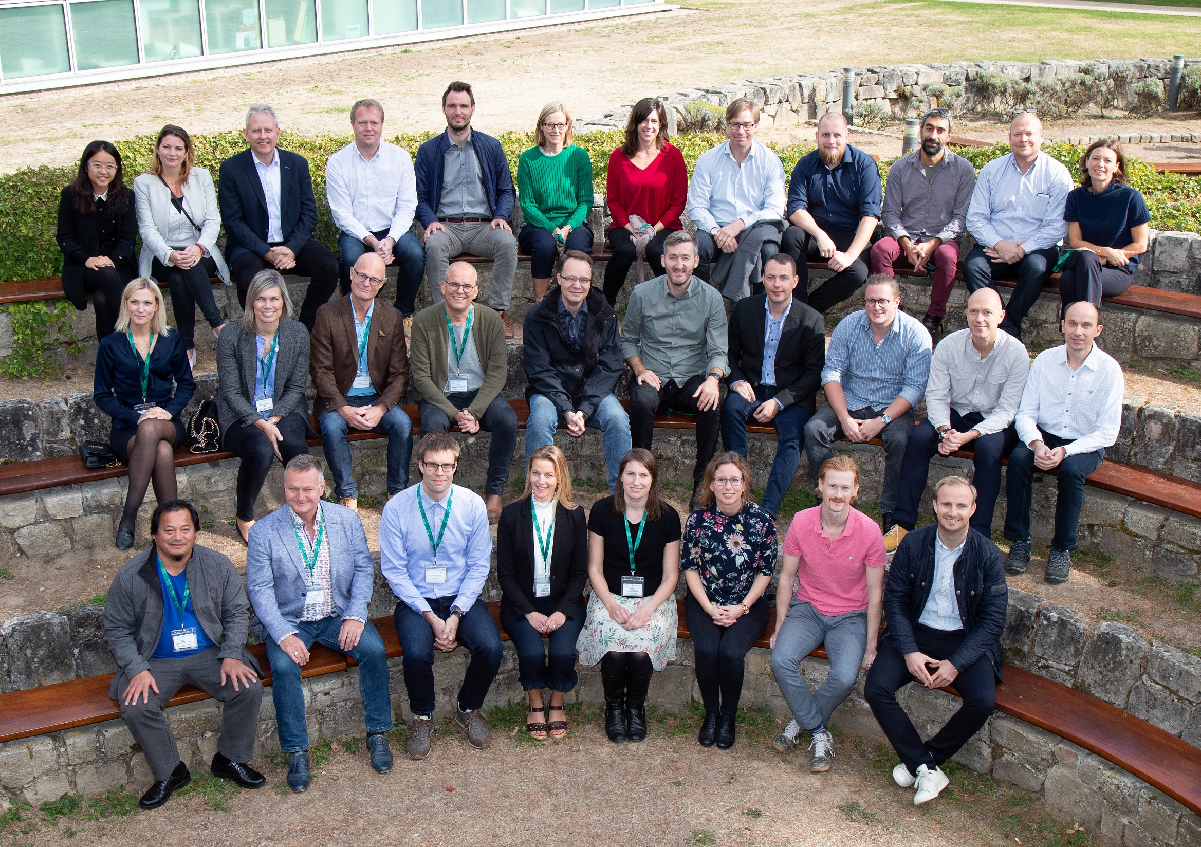
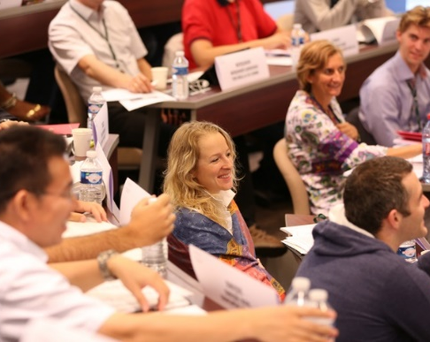
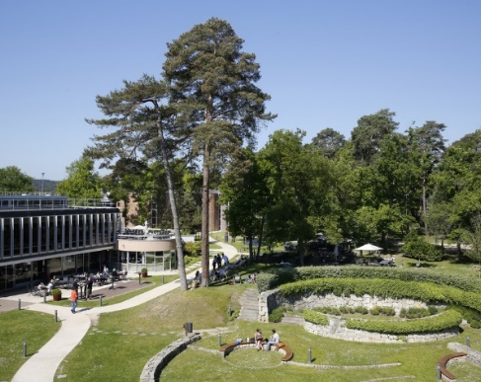

Making innovation happen
Notes:
Utroligt nok er der slet ingen deltagere fra Aarhus Universitet!!!

Slide 49
innovationsfonden.dk Newsletter: innovationsfonden.dk/nyhedsbreve Slides of today: innovationsfonden.dk/fonden2019

